Slide 1
IT5005 Artificial Intelligence
Lecture 5: Search Algorithms

Slide 2
Topics Covered
5.1 Motivation
5.2 Case Study
5.3 The Search Problem
5.4 Search Algorithms
5.5 Uninformed Search Algorithms
5.5.1 General Tree Search Algorithm
5.5.2 Breadth First Search
5.5.3 Depth First Search
5.5.4 Dijkstra’s Algorithm.
5.6 Informed Search Algorithms

Slide 3
Topics Covered
5.6 Informed Search Algorithms
5.6.1 Greedy Best First Search
5.6.2 A* Search
5.6.3 Admissibilty of Search Heuristics

Slide 4
Motivation
Search Algorithms

Slide 5
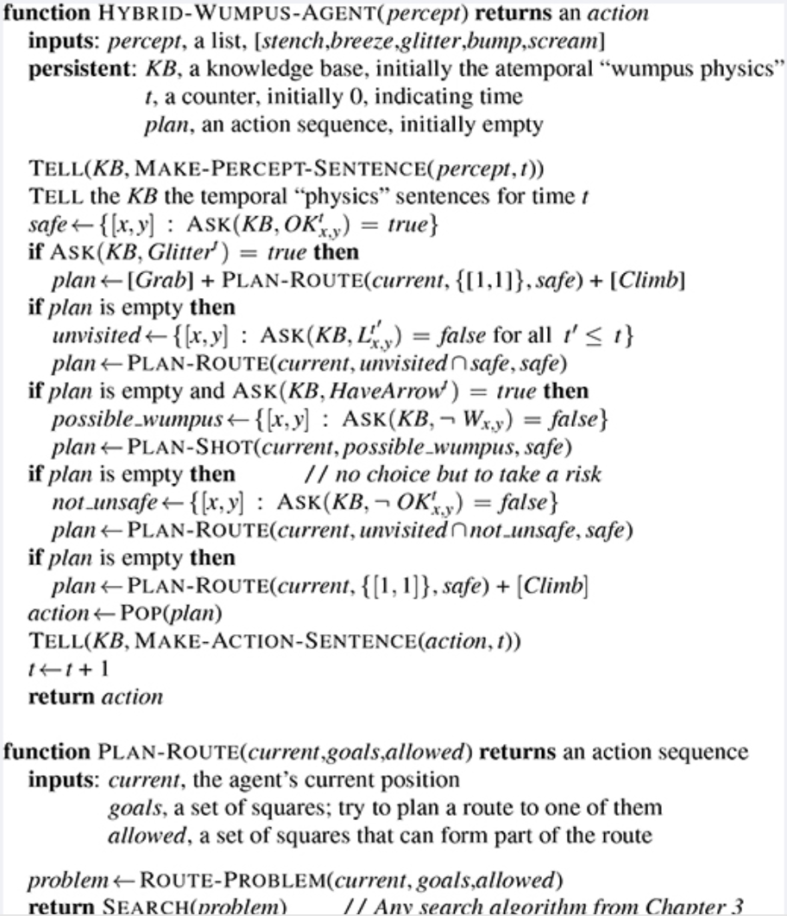
5.1 Motivation
We saw how logical agents are implemented:
Agents sense the world and create “percept statements” which are inserted into the KB.
Agents then apply inference rules to understand the world around it (e.g. is square (2, 2) safe in the Wumpus world?)
Agents plan accordingly to accomplish goals (explore maze, shoot Wumpus, take gold, etc.)

Slide 6
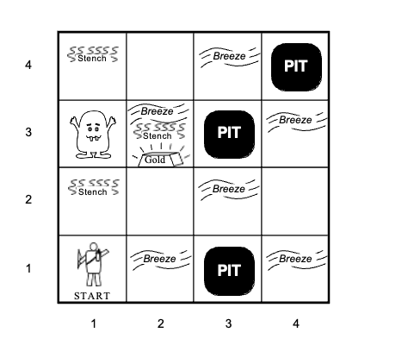
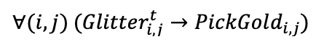
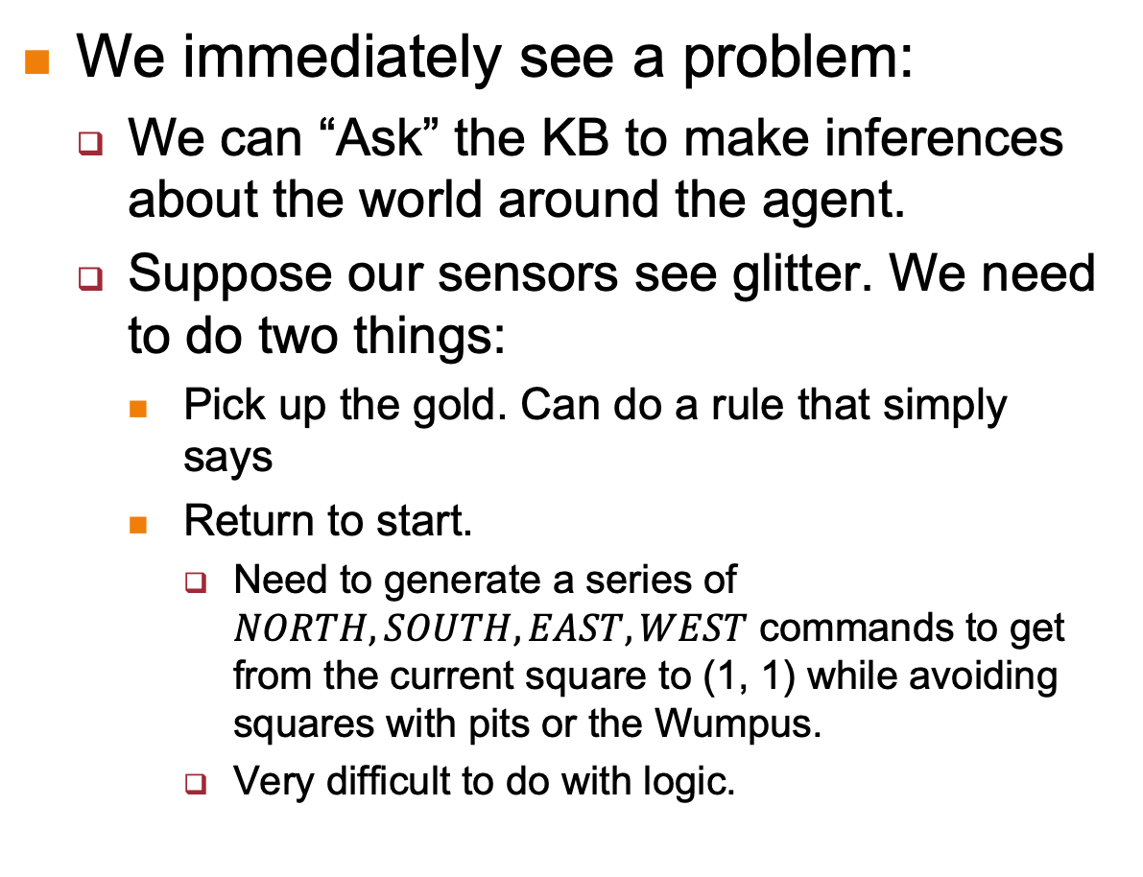
5.1 Motivation
We immediately see a problem:
We can “Ask” the KB to make inferences about the world around the agent.
Suppose our sensors see glitter. We need to do two things:
Pick up the gold. Can do a rule that simply says
Return to start.
Need to generate a series of $NORTH, SOUTH, EAST, WEST$ commands to get from the current square to (1, 1) while avoiding squares with pits or the Wumpus.
Very difficult to do with logic.

Slide 7
5.1 Motivation
To perform this we need to do “planning”.
For now we will assume that the agent has a full view of the world, i.e. there are no hidden unknowns.
In this lecture we will model planning as a search problem and explore two classes of search algorithms:
Uninformed Searches:
No information about how close we are to the goal, or about how good our move is.
Informed Searches:
With each step we get feedback of how close we are to the goal, or how good the move is.

Slide 8
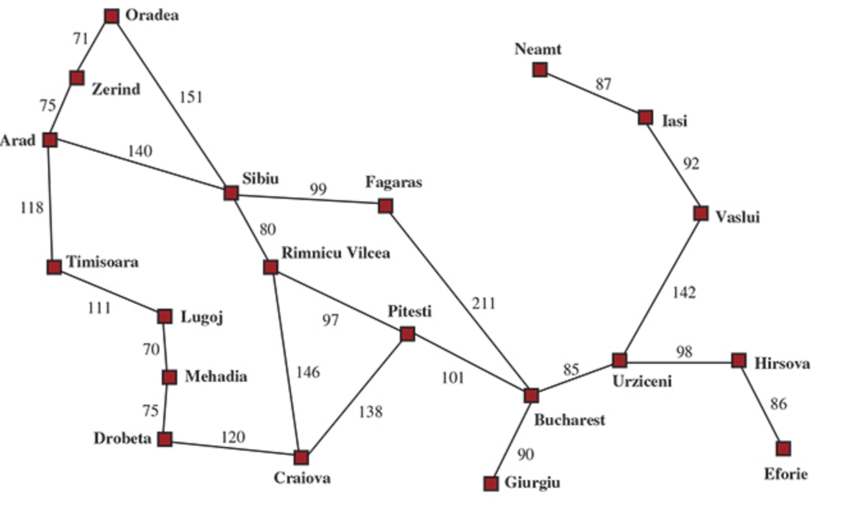
5.2 Case Study
We will consider an agent who wishes to tour Romania.
Agent is currently in Arad, and must get to Bucharest.
Agent has a complete map of Romania complete with distances.
I.e. Agent has a complete view of the “world”, in this case all the roads between major cities in Romani, and their distances.

Slide 9
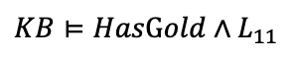
5.2 Case Study
We define our problem formally as follows:
A set of possible states S the environment can be in, called the state space.
Romania Problem: The set of possible cities
Wumpus World: The possible statements in the KB, the objective configuration of the world.
The initial state S_{0,} The set of starting values in our problem.
Romania Problem: Arad, the starting city.
Wumpus World: L_{11,} the starting square, HasArrow, etc.
The goal states G.
Romania Problem: Bucharest, the destination city.
Wumpus World:

Slide 10
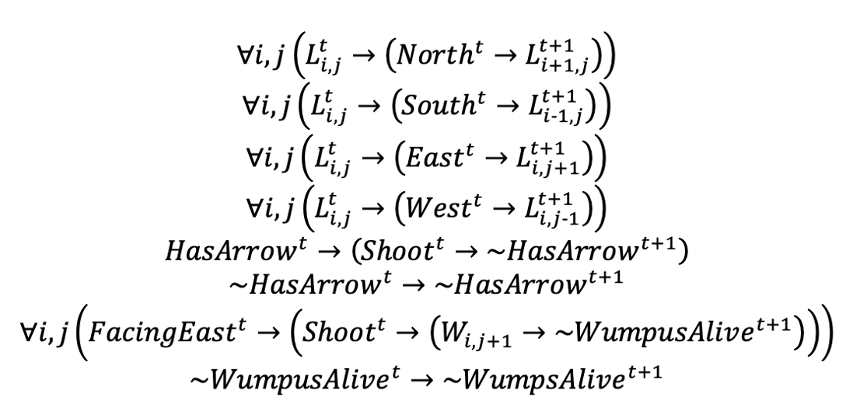
5.2 Case Study
The set of actions A(s) available to the agent at each state s.
We say these are the actions that are relevant to state s
Romania: A(Arad) = {ToSibiu, ToTimisoara, ToZerind}
Wumpus World: A(L₁₁) = {North, East, Shoot}
A transition function or model T(s, a) that tells us the next state as a result of taking action a in state s.
Romania: T(Arad, ToZerind) = Zerind
Wumpus World: The transition axioms, some of which are shown below

Slide 11
5.2 Case Study
Action cost c(s, a, s’). The cost of applying action a in state s to reach state s’.
Romania: c(Arad, ToSibiu, Sibiu) = 140
Wumpus: c(L₁₁, North, L₂₁) = 1

Slide 12
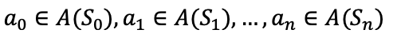
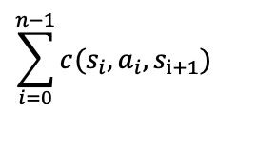
5.3 The Search Problem
Our ”problem solving” strategy can thus be described as:
Starting from our initial state S₀
Apply a series of actions
Note: A series of actions is called a “path”.
Until we reach some state in G
While (hopefully) minimizing:

Slide 13
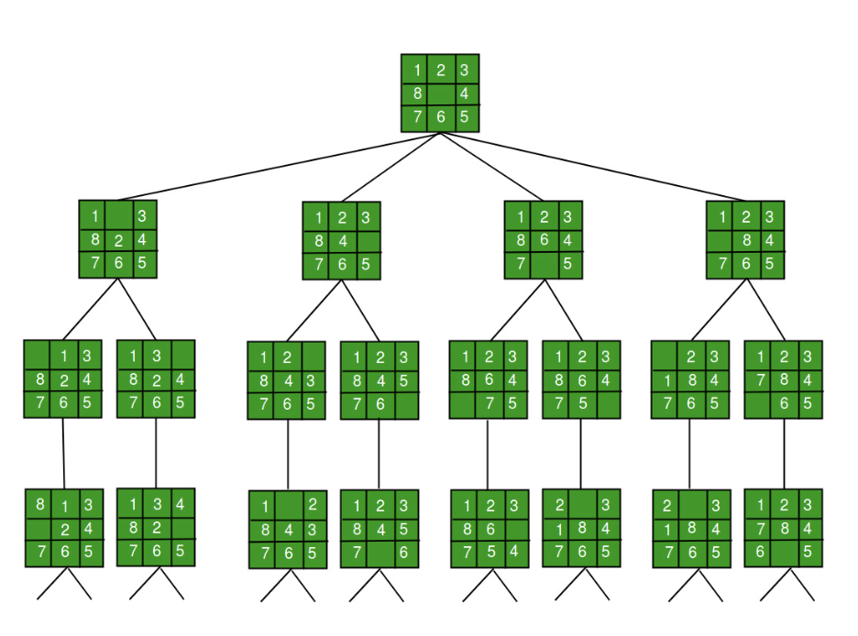
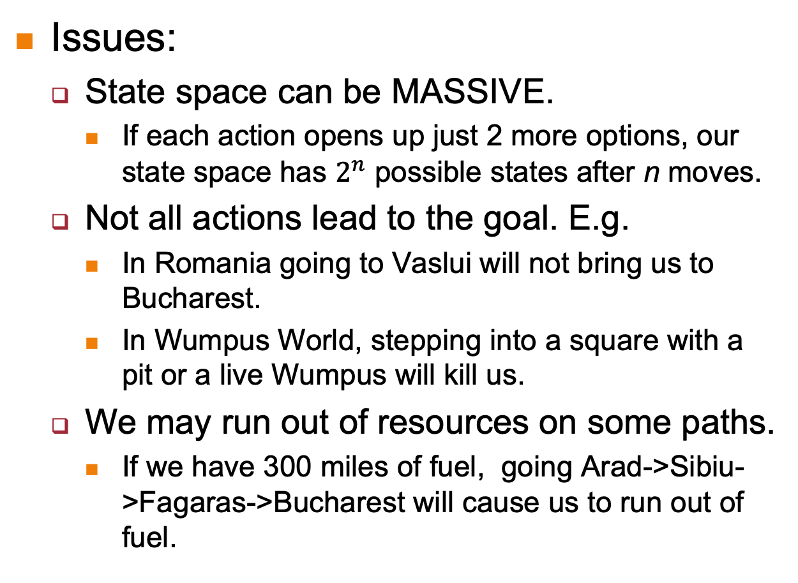
5.3 The Search Problem
Issues:
State space can be MASSIVE.
If each action opens up just 2 more options, our state space has $2^{n}$ possible states after n moves.
Not all actions lead to the goal. E.g.
In Romania going to Vaslui will not bring us to Bucharest.
In Wumpus World, stepping into a square with a pit or a live Wumpus will kill us.
We may run out of resources on some paths.
If we have 300 miles of fuel, going Arad->Sibiu->Fagaras->Bucharest will cause us to run out of fuel.

Slide 14
5.3 The Search Problem
For this reason we need to use search algorithms that:
Sensibly expand the set of options available,
See if it leads to the goal state,
While (hopefully) minimizing costs.
Formally, a search algorithm:
Takes a search problem as inputs.
Returns a solution in the form of a series of actions to be taken, OR
Returns failure if no such solution exists.

Slide 15
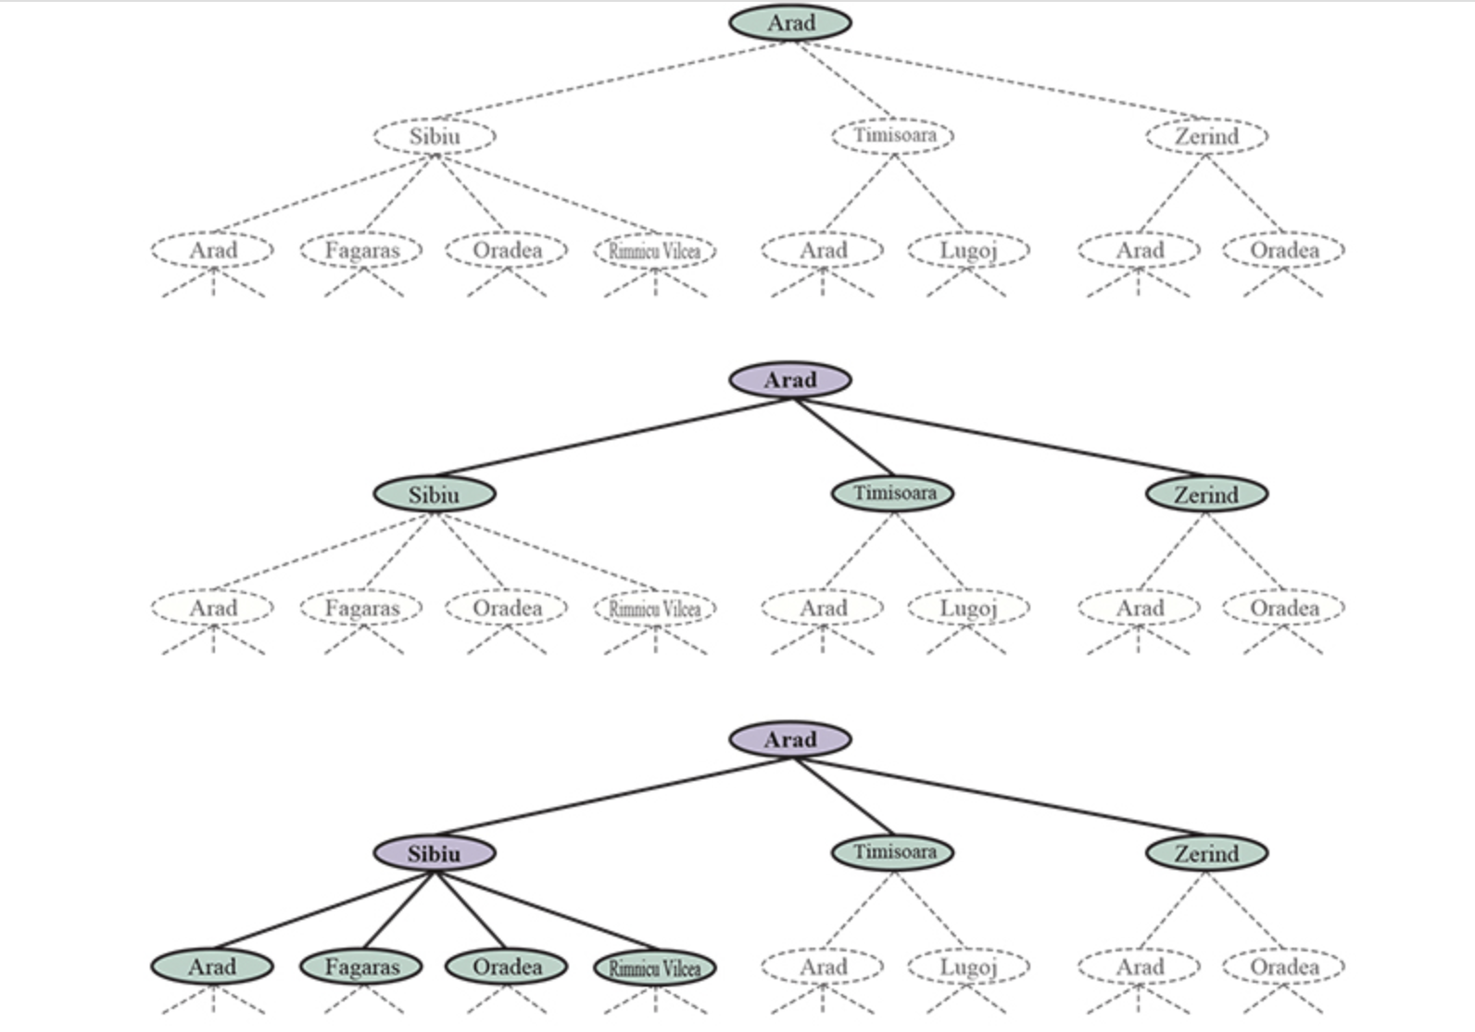
5.3 The Search Problem
We begin by first overlaying a tree on the problem, based on the possible set of actions at each state and their consequences:
Some nodes have been expanded:
the options reachable from those nodes have been generated.
E.g. Arad in the second tree, Arad and Sibiu in the third tree.
Some nodes are generated but not yet expanded (nodes in green).
These are called “frontier nodes”
Frontier nodes and expanded nodes are collectively called “reached nodes”.
Arad is visited and expanded.
Fagaras has been visited but not expanded.

Slide 16
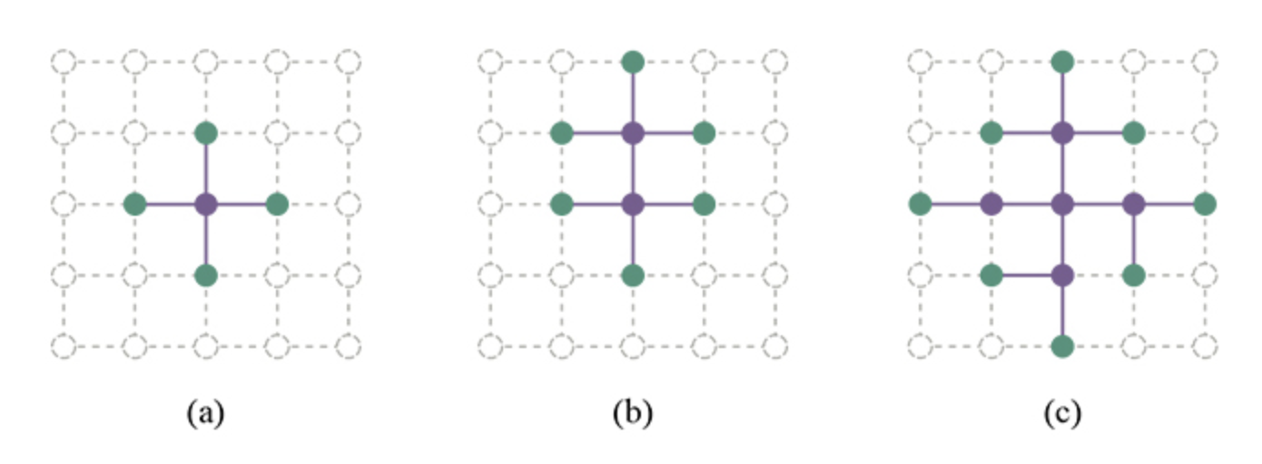
5.3 The Search Problem
The Separation Property of Search Algorithms
Frontier nodes separate interior “expanded” nodes from exterior “unreached” nodes

Slide 17
5.4 Search Algorithms
Having seen how to model our search problem as a tree, and having seen the definition of reached, expanded and frontier nodes, we are now ready to examine search algorithms.
Some terminology:
State: A representation of the physical configuration. E.g. being in square L₁₁ with an arrow in the Wumpus World.
Node: A data structure that is part of the search tree, containing information about:
The parent node, children, depth, path cost.

Slide 18
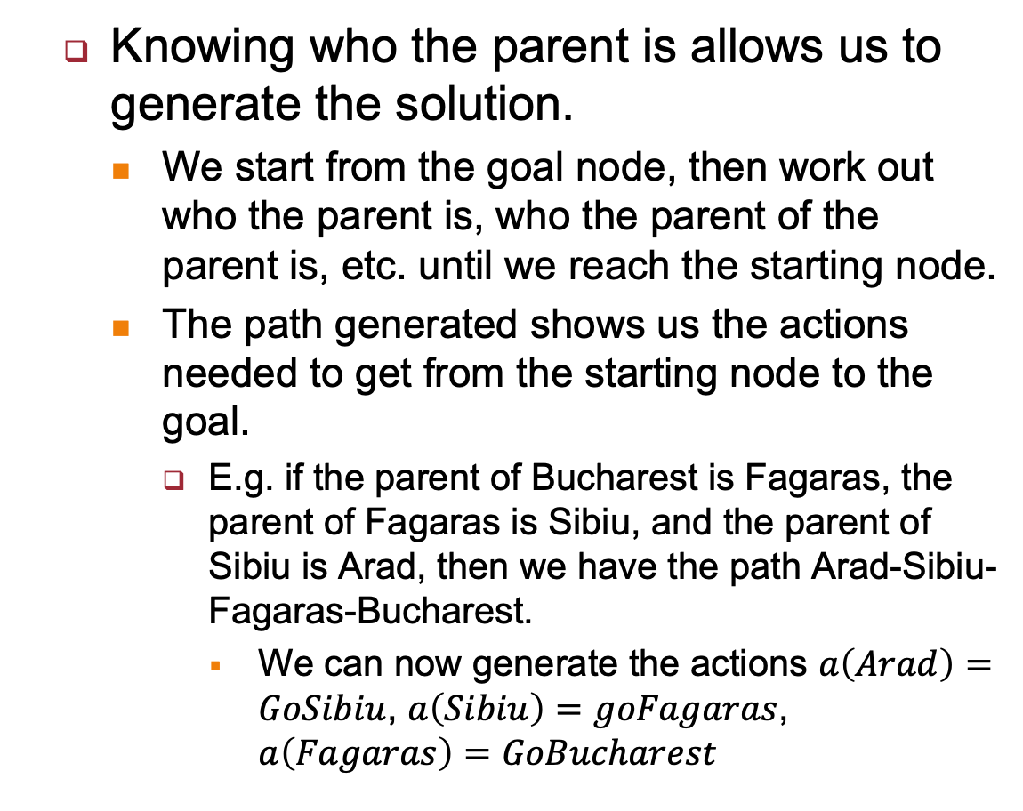
5.4 Search Algorithms
Knowing who the parent is allows us to generate the solution.
We start from the goal node, then work out who the parent is, who the parent of the parent is, etc. until we reach the starting node.
The path generated shows us the actions needed to get from the starting node to the goal.
E.g. if the parent of Bucharest is Fagaras, the parent of Fagaras is Sibiu, and the parent of Sibiu is Arad, then we have the path Arad-Sibiu-Fagaras-Bucharest.
We can now generate the actions $a\left(Arad\right)=GoSibiu$, $a\left(Sibiu\right)=goFagaras$, $a\left(Fagaras\right)=GoBucharest$

Slide 19
5.5 Uninformed Search Algorithms
We will now look at some uninformed search algorithms:
Generalized Tree Search Algorithm (aka “Best-Fit”)
Breadth First Search
Depth First Search
Dijkstra’s Algorithm

Slide 20
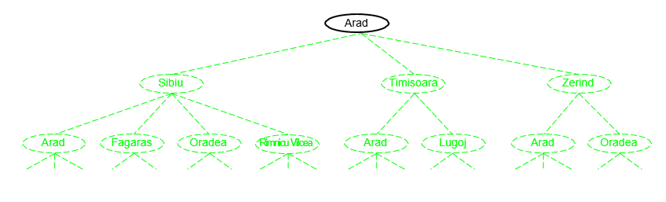
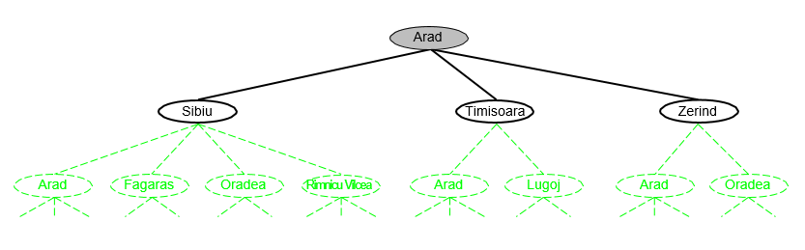
5.5.1 General Tree Search

Slide 21
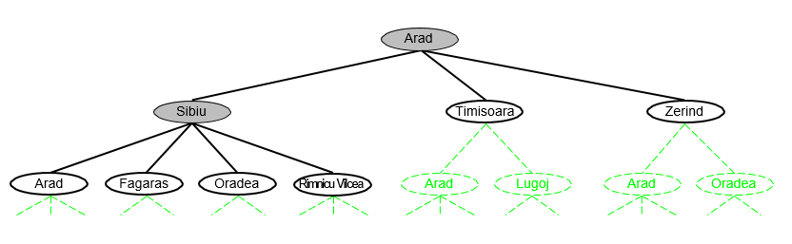
5.5.1 General Tree Search

Slide 22
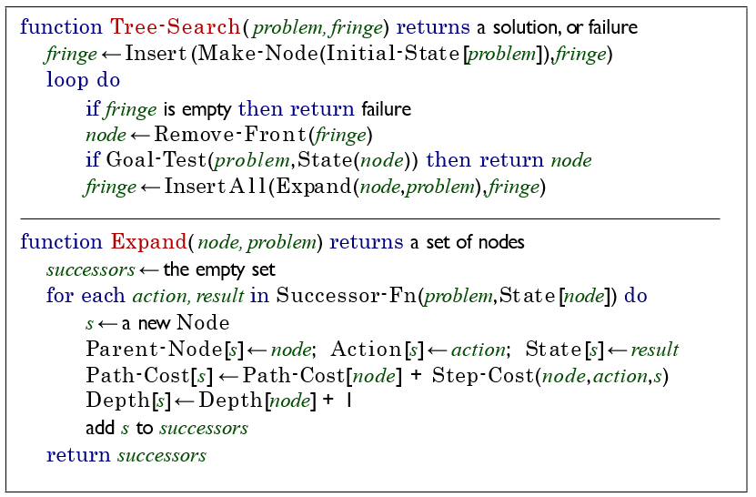
5.5.1 General Tree Search
Basic idea:
Remove node from the fringe – the set of nodes that have been visited but not expanded.
Apply every relevant action for that node and get the result.
Create a new node, store the current node as parent.
Store the action that allowed us to get here.
Store the outcome.
Add all generated nodes to the fringe for evaluation.

Slide 23
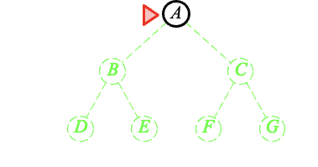
5.5.2 Breadth First Search
Strategy: Expand the shallowest unexpanded node.
Implement the fringe as a FIFO queue. New nodes are added to the end.

Slide 24
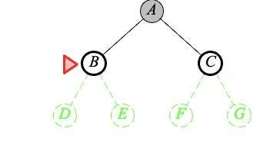
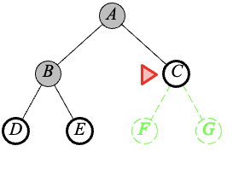
5.5.2 Breadth First Search

Slide 25
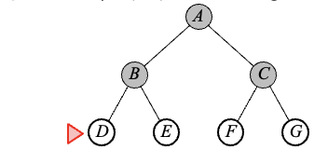
5.5.2 Breadth First Search

Slide 26
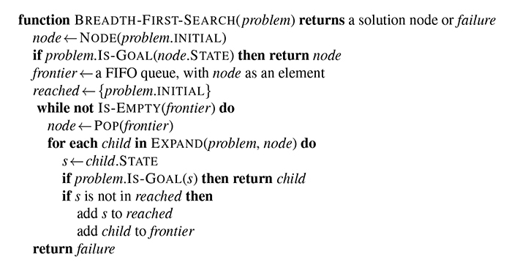
5.5.2 Breadth First Search

Slide 27
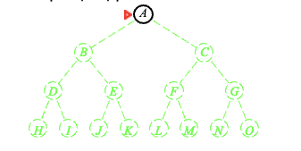
5.5.3 Depth First Search
Strategy: Expand deepest unexpanded node.
Implement fringe as a LIFO queue. Newly generated nodes are put in front.

Slide 28
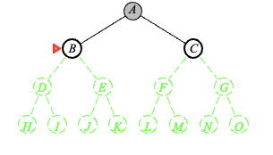
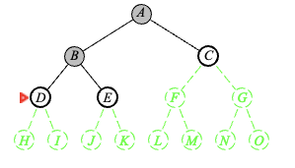
5.5.3 Depth First Search

Slide 29
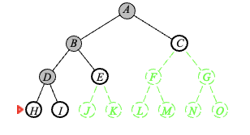
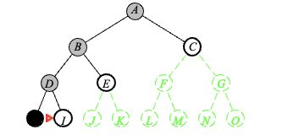
5.5.3 Depth First Search

Slide 30
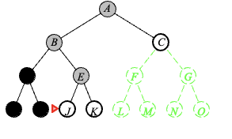
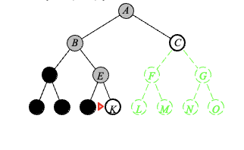
5.5.3 Depth First Search

Slide 31
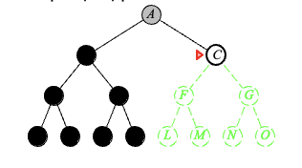
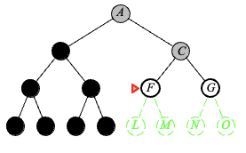
5.5.3 Depth First Search

Slide 32
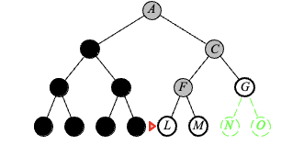
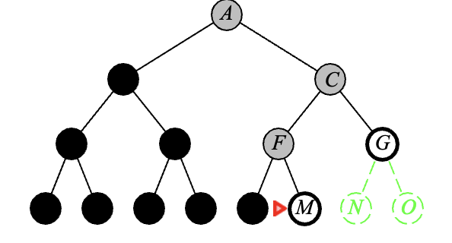
5.5.3 Depth First Search

Slide 33
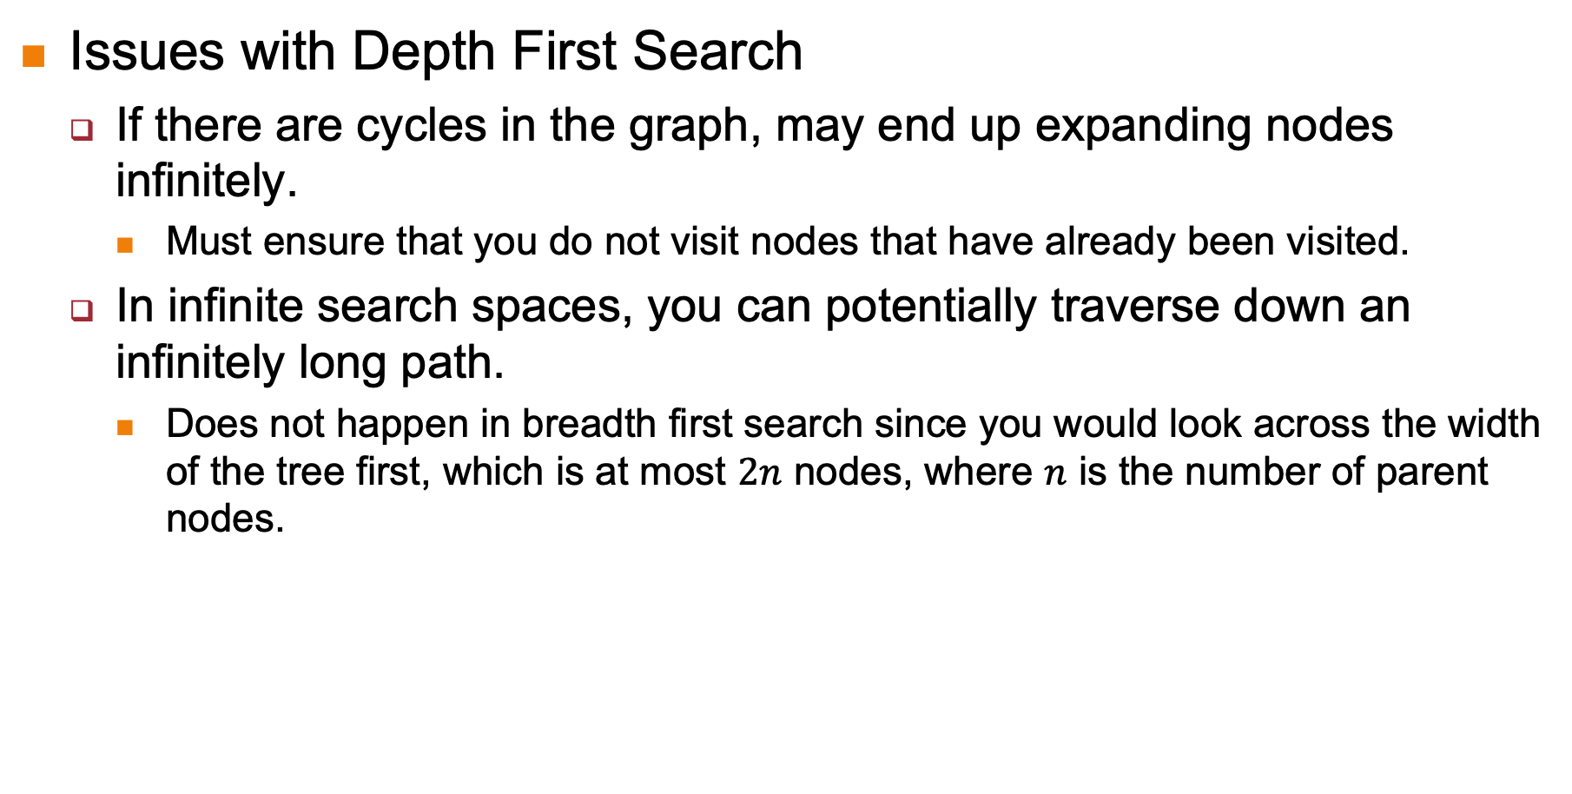
5.5.3 Depth First Search
Issues with Depth First Search
If there are cycles in the graph, may end up expanding nodes infinitely.
Must ensure that you do not visit nodes that have already been visited.
In infinite search spaces, you can potentially traverse down an infinitely long path.
Does not happen in breadth first search since you would look across the width of the tree first, which is at most $2n$ nodes, where $n$ is the number of parent nodes.

Slide 34
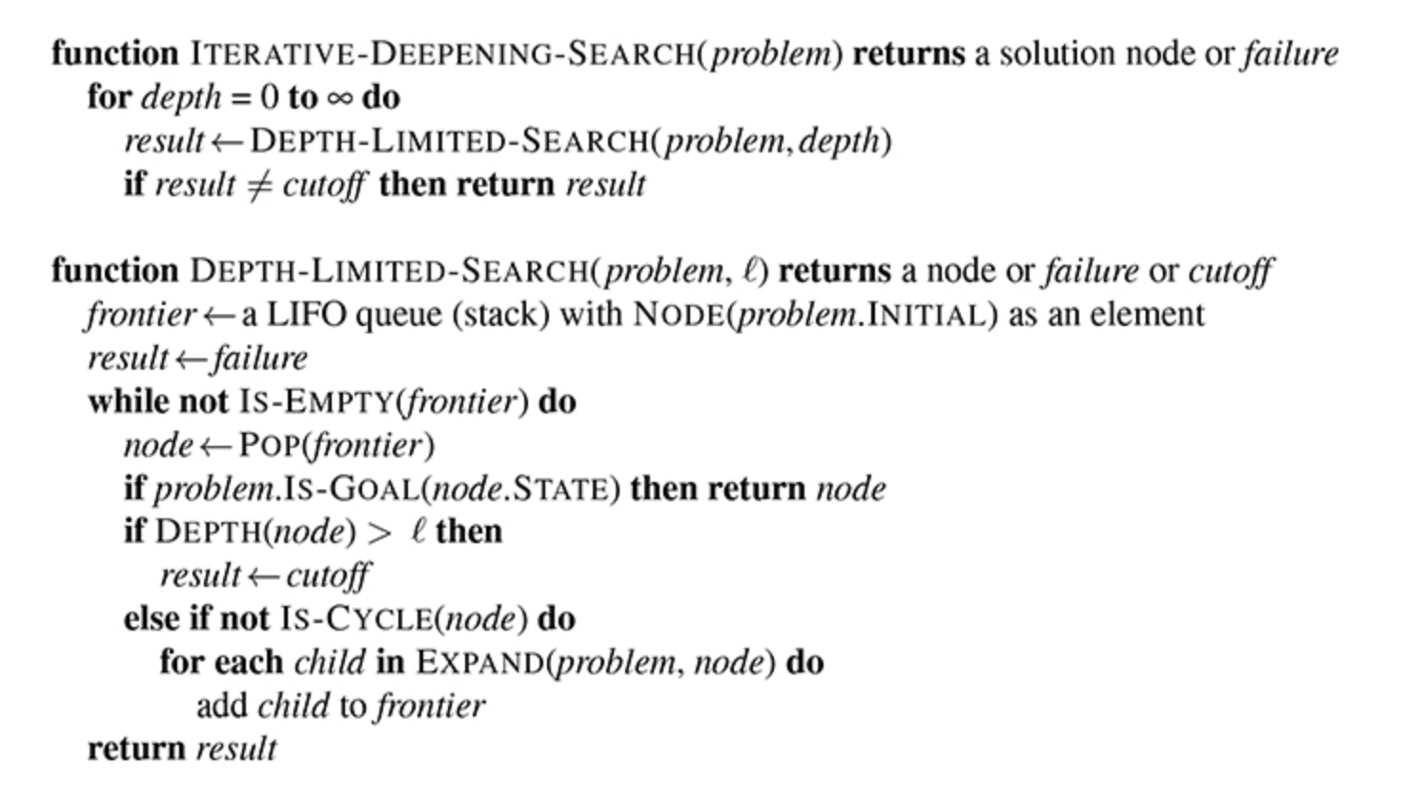
5.5.3 Depth First Search
Use iterative deepening to solve the “infinite depth” problem.
Idea:
Do DFS on a tree with 2 levels, then 3 levels, then 4 levels etc till we find the goal node.

Slide 35
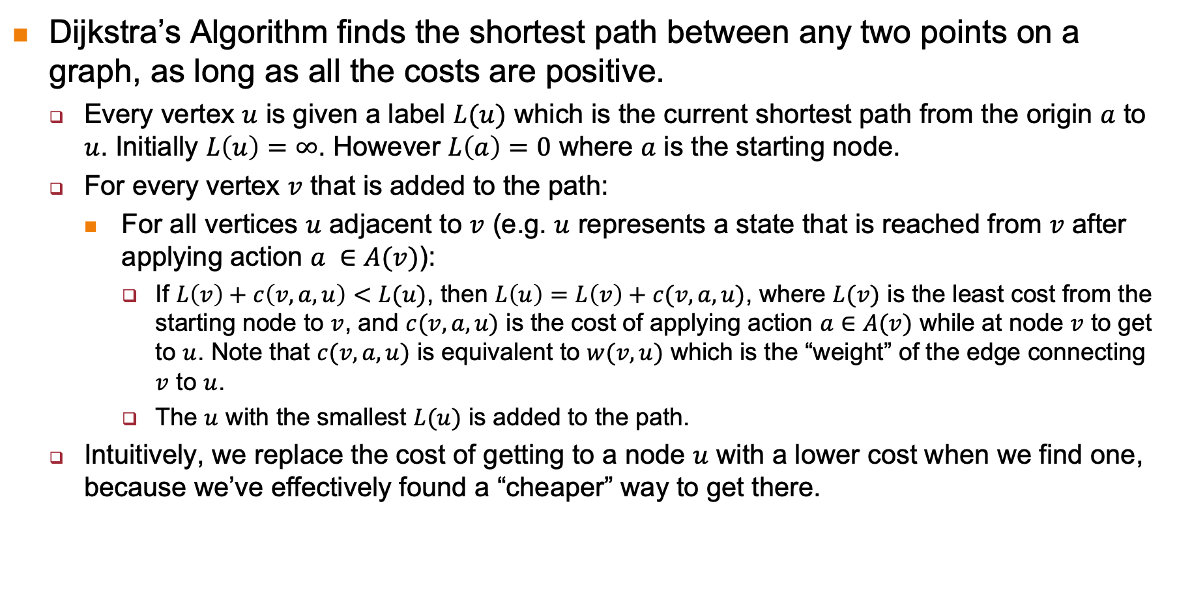
5.5.4 Dijkstra’s Algorithm
Dijkstra’s Algorithm finds the shortest path between any two points on a graph, as long as all the costs are positive.
Every vertex $u$ is given a label $L(u)$ which is the current shortest path from the origin $a$ to $u$. Initially $L\left(u\right)=∞$. However $L\left(a\right)=0$ where $a$ is the starting node.
For every vertex $v$ that is added to the path:
For all vertices $u$ adjacent to $v$ (e.g. $u$ represents a state that is reached from $v$ after applying action $a ∈A(v)$):
If $L\left(v\right)+c\left(v, a, u\right)<L(u)$, then $L\left(u\right)=L\left(v\right)+c(v, a, u)$, where $L(v)$ is the least cost from the starting node to $v$, and $c(v, a, u)$ is the cost of applying action $a∈A(v)$ while at node $v$ to get to $u$. Note that $c(v, a, u)$ is equivalent to $w(v, u)$ which is the “weight” of the edge connecting $v$ to $u$.
The $u$ with the smallest $L(u)$ is added to the path.
Intuitively, we replace the cost of getting to a node $u$ with a lower cost when we find one, because we’ve effectively found a “cheaper” way to get there.

Slide 36
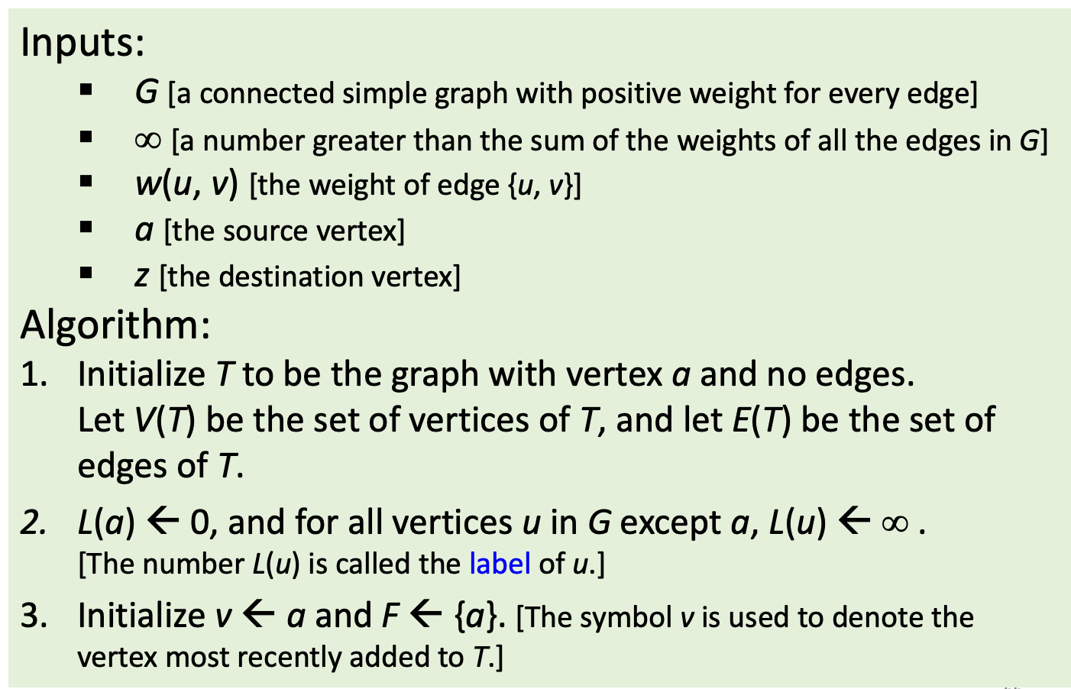
5.5.4 Dijkstra’s Algorithm

Slide 37
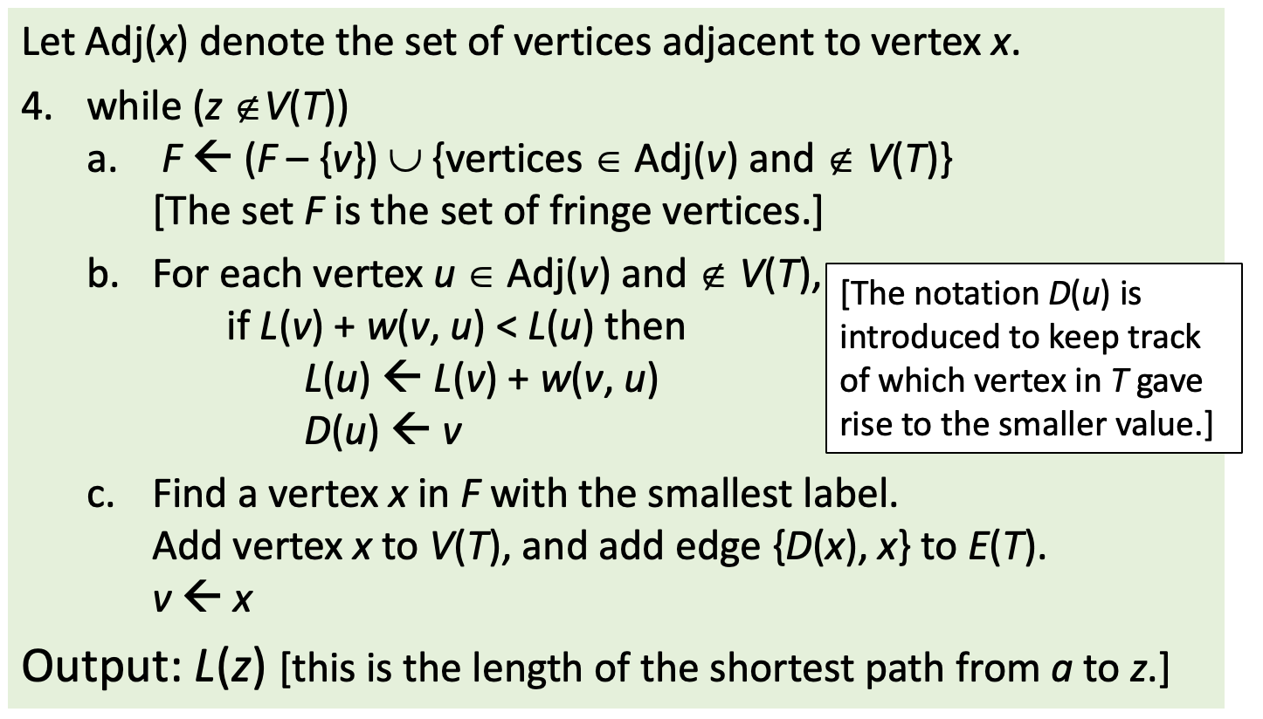
5.5.4 Dijkstra’s Algorithm

Slide 38
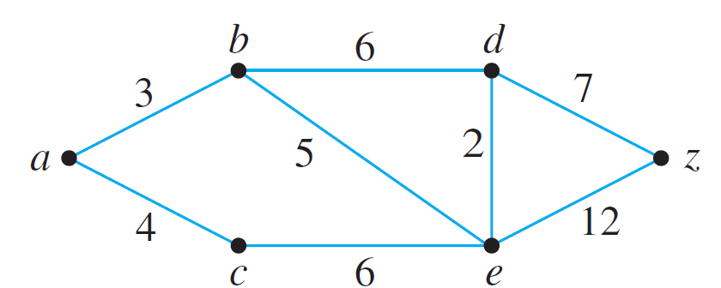
5.5.4 Dijkstra’s Algorithm
Example: Show the steps in the execution of Dijkstra’s shortest path algorithm for the graph shown below with starting vertex a and ending vertex z.
1

Slide 39
5.5.4 Dijkstra’s Algorithm
∞
∞
3
Step 1: Going into the while loop: V(T ) = {a}, E(T ) = Ø, and F = {a}
0
∞
∞
1
∞
During iteration:
F = {b, c}, L(b) = 3, L(c) = 4.
Since L(b) < L(c), b is added to V(T) and {a, b} is added to E(T).

Slide 40
5.5.4 Dijkstra’s Algorithm
3
∞
Step 2: Going into the while loop: V(T ) = {a, b}, E(T ) = {{a, b}}
0
∞
4
∞
∞
1
During iteration:
F = {c, d, e}, L(c) = 4, L(d) = 9, L(e) = 8.
Since L(c) < L(d) and L(c) < L(e), c is added to V(T) and {a, c} is added to E(T).

Slide 41
5.5.4 Dijkstra’s Algorithm
3
∞
Step 3: Going into the while loop: V(T ) = {a, b, c},
E(T ) = {{a, b}, {a, c}}
0
∞
∞
4
1
5
During iteration:
F = {d, e}, L(d) = 9, L(e) = 5.
L(e) becomes 5 because ace, which has length 5, is a shorter path to e than abe, which has length 8. Since L(e) < L(d), e is added to V(T ) and {c, e} is added to E(T ).

Slide 42
5.5.4 Dijkstra’s Algorithm
∞
3
7
Step 4: Going into the while loop: V(T ) = {a, b, c, e},
E(T ) = {{a, b}, {a, c}, {c, e}}
0
∞
4
1
5
During iteration:
F = {d, z}, L(d) = 7, L(z) = 17. L(d) becomes 7 because aced, which has length 7, is a shorter path to d than abd, which has length 9. Since L(d) < L(z), d is added to V(T ) and {e, d} is added to E(T ).

Slide 43
5.5.4 Dijkstra’s Algorithm
Step 5: Going into the while loop: V(T ) = {a, b, c, e , d},
E(T ) = {{a, b}, {a, c}, {c, e}, {e, d}}
3
7
0
∞
14
4
1
5
During iteration:
F = {z}, L(z) = 14. L(z) becomes 14 because acedz, which has length 14, is a shorter path to z than acez, which has length 17. Since z is the only vertex in F, its label is a minimum, and so z is added to V(T ) and {d, z} is added to E(T ).
Algorithm terminates at this point because z ∈ V(T).
The shortest path from a to z has length L(z) = 14.

Slide 44
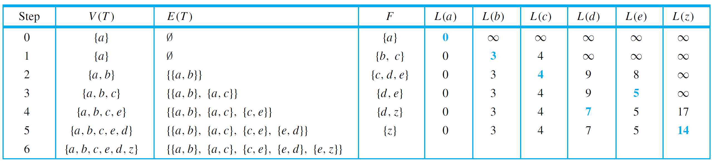
5.5.4 Dijkstra’s Algorithm
Keeping track of the steps in a table is a convenient way to show the action of Dijkstra’s algorithm. Table 10.7.1 does this for the graph in the previous example.
{d, z}}
Table 10.7.1

Slide 45
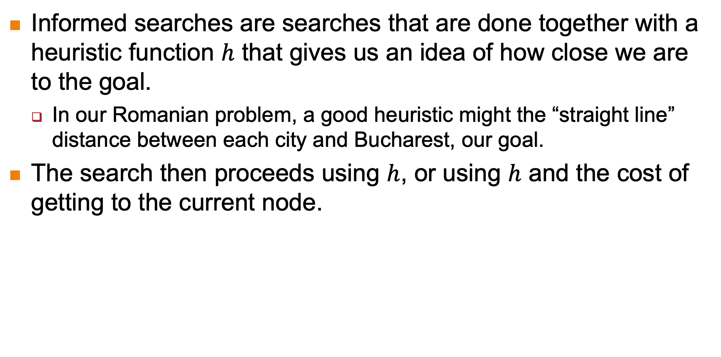
5.6 Informed Search
Informed searches are searches that are done together with a heuristic function $h$ that gives us an idea of how close we are to the goal.
In our Romanian problem, a good heuristic might the “straight line” distance between each city and Bucharest, our goal.
The search then proceeds using $h$, or using $h$ and the cost of getting to the current node.

Slide 46
5.6 Informed Search
We will look at two informed search algorithms:
Greedy Best First Search
A* Search

Slide 47
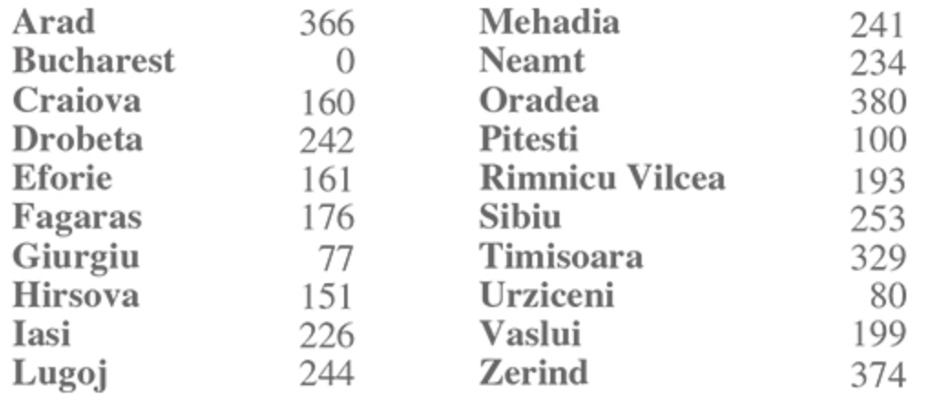
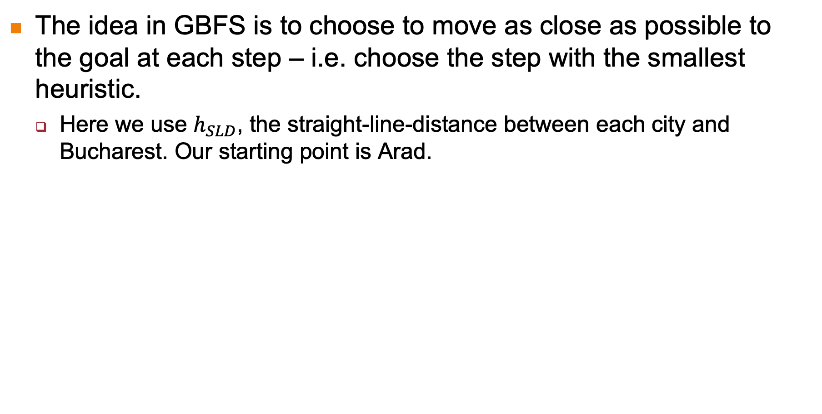
5.6.1 Greedy Best First Search
The idea in GBFS is to choose to move as close as possible to the goal at each step – i.e. choose the step with the smallest heuristic.
Here we use $h_{SLD}$, the straight-line-distance between each city and Bucharest. Our starting point is Arad.

Slide 48
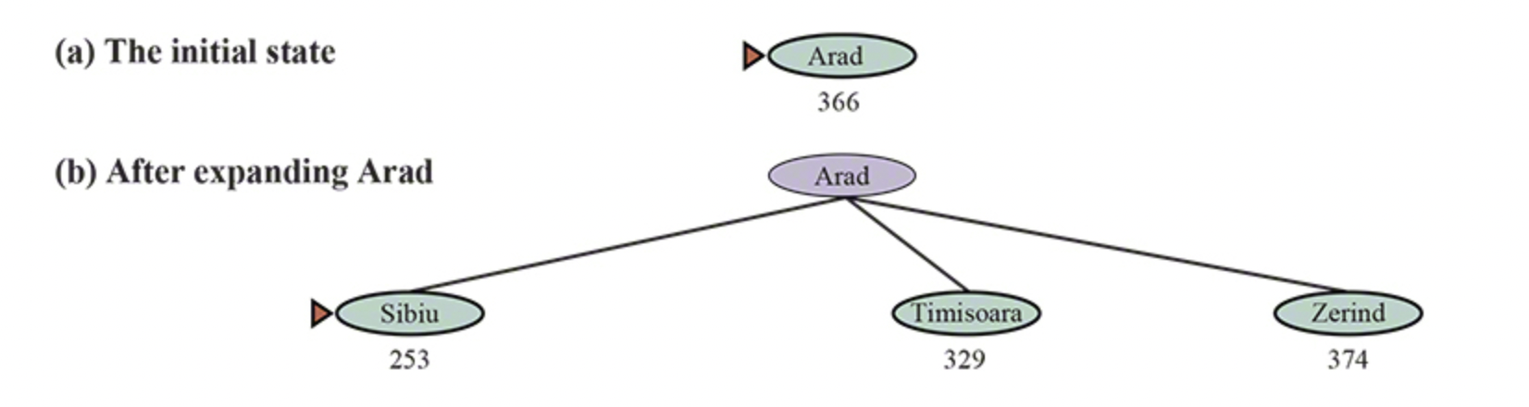
5.6.1 Greedy Best First Search

Slide 49
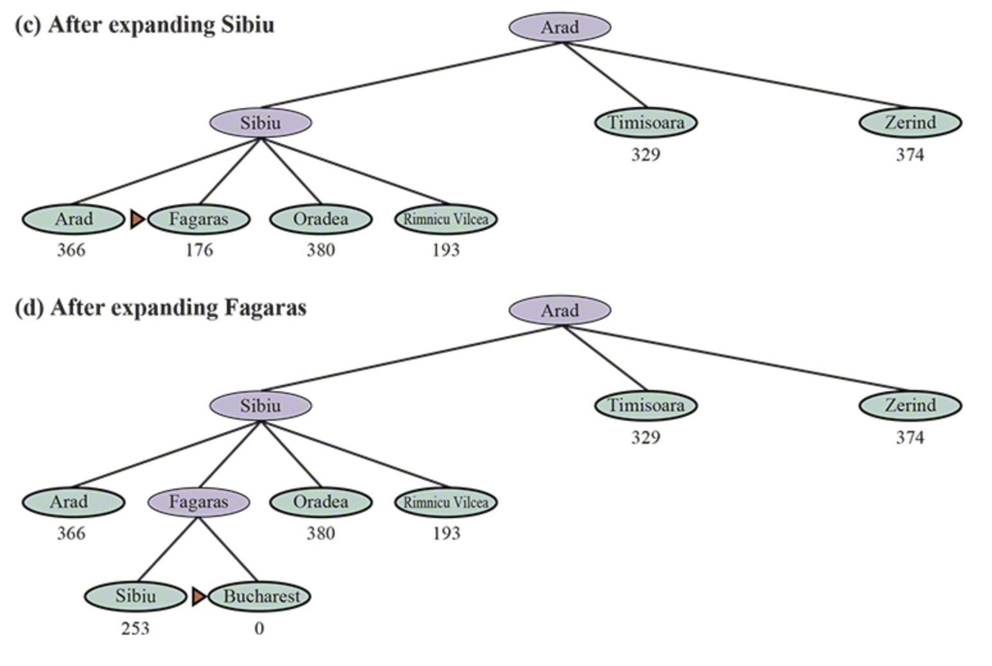
5.6.1 Greedy Best First Search

Slide 50
5.6.1 Greedy Best First Search
Unfortunately GBFS does not produce an optimal solution.
Our current solution is Arad-Sibiu-Fagaras-Bucharest, with a total distance of 140 + 99 +211 = 450 miles.
The actual optimal solution is Arad-Sibiu-Rimincu Vilcea-Pitesti-Bulgaria, which has a distance of 140 + 80 + 97 + 101 = 418 miles, 32 miles shorter.
This is because greedy algorithms do not consider the “big picture”, but just greedily pick the current “best” solution.

Slide 51
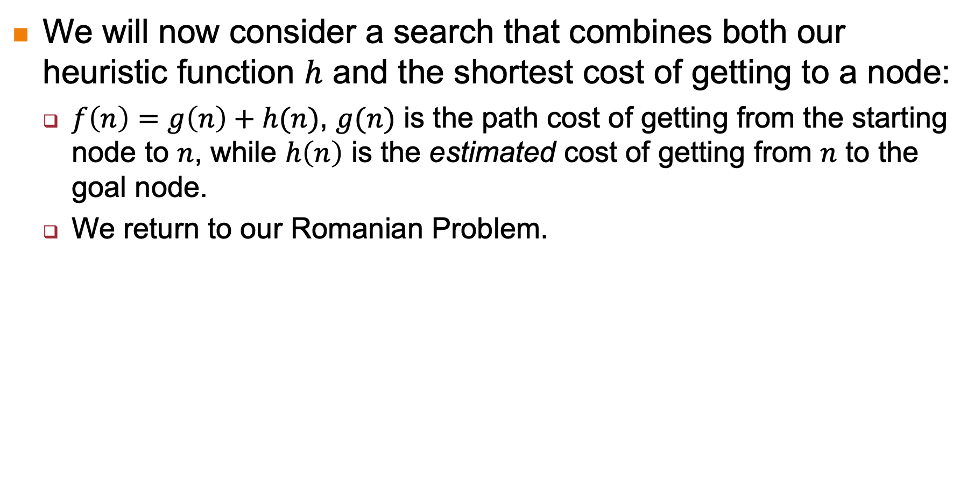
5.6.2 A* Search
We will now consider a search that combines both our heuristic function $h$ and the shortest cost of getting to a node:
$f\left(n\right)=g\left(n\right)+h(n)$, $g(n)$ is the path cost of getting from the starting node to $n$, while $h\left(n\right)$ is the estimated cost of getting from $n$ to the goal node.
We return to our Romanian Problem.

Slide 52
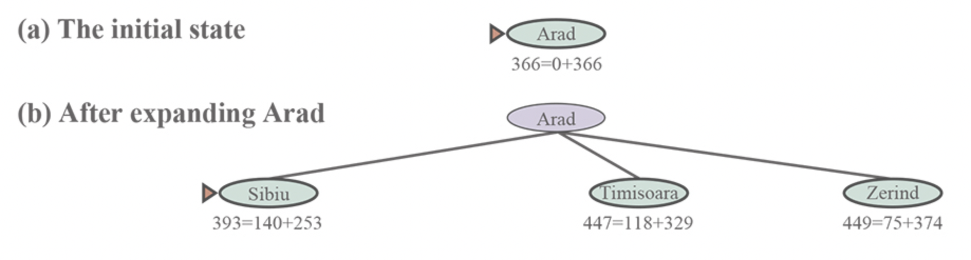
5.6.2 A* Search

Slide 53
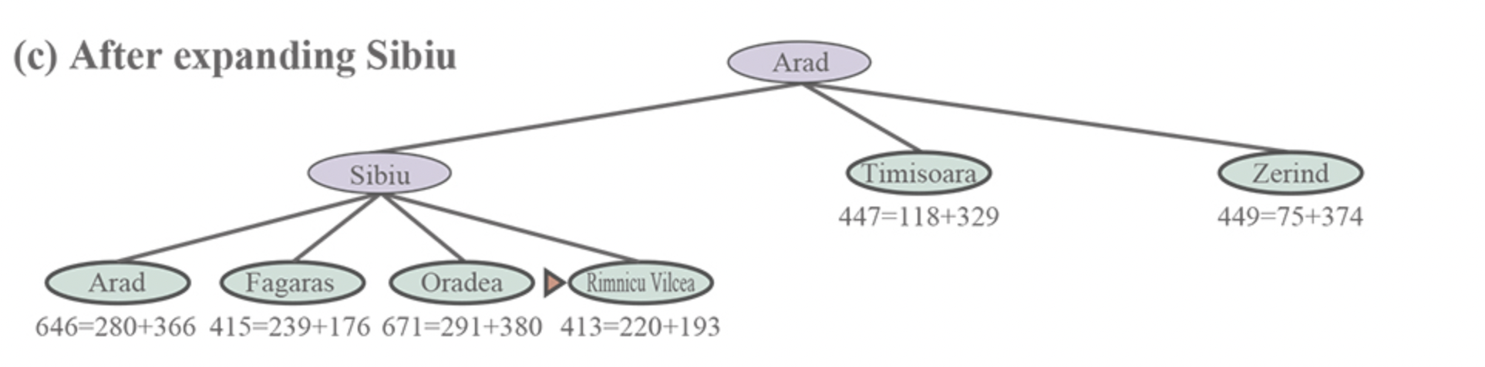
5.6.2 A* Search

Slide 54
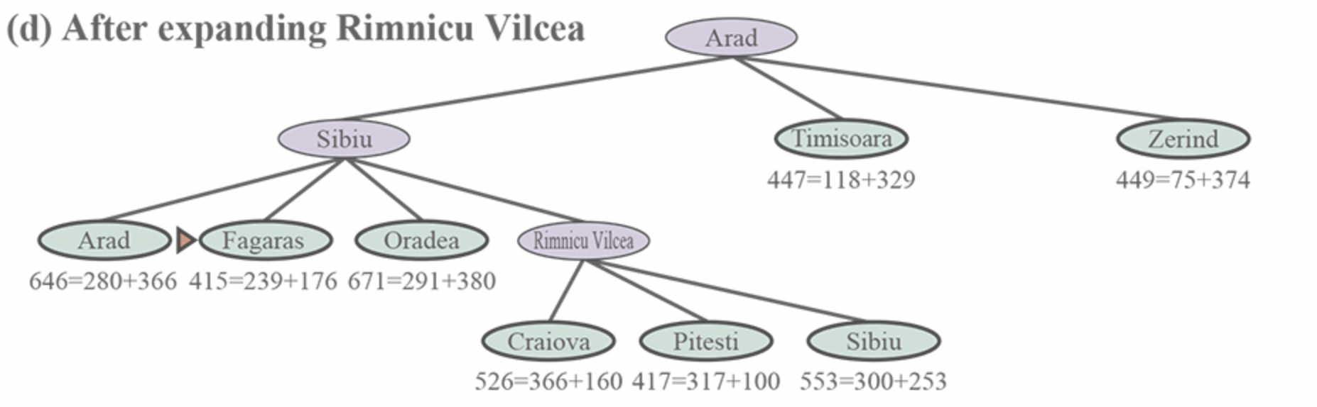
5.6.2 A* Search

Slide 55

5.6.2 A* Search

Slide 56

5.6.2 A* Search

Slide 57
5.6.3 Admissibility of Heuristic Functions
To guarantee an optimal solution, a heuristic must under-estimate the actual cost of reaching the goal.
E.g. our straight-line distance to Bucharest will invariably be shorter than the actual distance, since roads curve, we need to go around lakes and mountains, etc.
A heuristic that under-estimates the true cost is called “admissible”.

Slide 58

5.6.3 Admissibility of Heuristic Functions
We can prove that admissible functions always generate optimal solutions:

Slide 59


5.6.3 Admissibility of Heuristic Functions
Another property is called “consistency”, which is:
All consistent heuristics are admissible, but not vice-versa.
This idea is shown below:

Slide 60
5.7 Conclusion
The goal of search algorithms:
To find a solution to a problem by progressively searching the state space.
Two approaches:
Uninformed approach: Selection is made solely based on order of expansion (breadth-first, depth-first) or on total cost (Dijkstra).
Informed approach: Selection is made based on a heuristic (greedy best first) or a heuristic and total cost (A*).
Next week we will look at adversarial algorithms.

Slide 61
END OF FILE

